Slide 1
TDD Hands-On <1>
Wei Xiao
June 5, 2015

Slide 2
TDD Cycle
Test Fails
Test Pass
Refactor

Slide 3
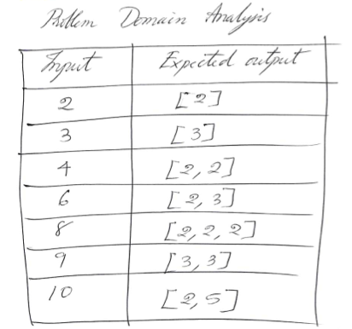
Exercise
Factorize a positive integer number into its prime factors.
找出一个正整数的所有质因数

Slide 4
Arrange – Act - Assert
[Test]
public void should_be_able_to_add_two_numbers_together()
{
int firstNumber = 1;
Calculator calculator = new Calculator();
int secondNumber = 2;
var result = calculator.Add(firstNumber, secondNumber); result.ShouldEqual(3);
}
[Test] public void should_be_able_to_add_two_numbers_together()
{
// Arrange
int firstNumber = 1;
int secondNumber = 2;
Calculator calculator = new Calculator();
// Act
var result = calculator.Add(firstNumber, secondNumber);
//Assert
result.ShouldEqual(3);
}

Slide 5
DEMO
https://vimeo.com/97516288
Start from 32’50

Slide 6
Transformation Priority Premise (TPP)
http://blog.8thlight.com/uncle-bob/2013/05/27/TheTransformationPriorityPremise.html
• ({}–>nil) no code at all->code that employs nil
• (nil->constant)
• (constant->constant+) a simple constant to a more complex constant
• (constant->scalar) replacing a constant with a variable or an argument
• (statement->statements) adding more unconditional statements.
• (unconditional->if) splitting the execution path
• (scalar->array)
• (array->container)
• (statement->recursion)
• (if->while)
• (expression->function) replacing an expression with a function or algorithm
• (variable->assignment) replacing the value of a variable.

Slide 7
TDD is design tool or testing tool ??

Slide 8
Classicist TDD
Design happens during the refactoring phase.
During the refactoring phase, the unit under test may grow to multiple classes.
Mocks are rarely used, unless when isolating external systems.
No up-front design considerations are made. Design completely emerges from code.
It’s a great way to avoid over-engineering.
Often used in conjunction with the 4 Rules of Simple Design.
Good for exploration, when we know what the input and desired output are but we don’t really know how the implementation looks like.
Great for cases where we can’t rely on a domain expert or domain language (data transformation, algorithms, etc.)
http://codurance.com/2015/05/12/does-tdd-lead-to-good-design/

Slide 9
Outside-In TDD
Prescribes a direction in which we start test-driving our code: from outside to the inside.
Design starts in the red phase, while writing the tests.
Design is refined during the refactoring phase.
We normally start with an acceptance test which verifies if the feature as a whole works. With a failing acceptance test informing why the feature is not yet complete. we start writing unit tests.
Starts from classes that are closer to the input of the system (outside) and move towards the inside of our application
Refactoring phases are much smaller, when compared to the classicist approach.

Slide 10
Which One Is Better?
TDD becomes much easier when we understand what good design looks like.

Slide 11
Good Design Guidelines
4 Rules of Simple Design
Domain Driven Design
SOLID
Patterns
Law of Demeter
Tell Don’t Ask
Design by Contract
Feature Envy
Cohesion and Coupling
Balanced Abstraction Principle

Slide 12
TDD is workflow
Starts with confidence
Deals with specific cases then
Concludes generic cases
Prompts for code improvement

Slide 13
Homework
Give number between 0 to 99, return its English word, E.g.
给出任意个0-99的数字，返回数字的英文。比如
0 → Zero
10 → Ten
21 → Twenty One
99 → Ninety Nine

